Slide 1
Neurons, Neural Networks, and Linear Discriminants

Slide 2
McCulloch-Pitts Neurons

Slide 3
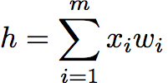
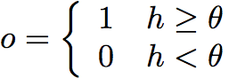
McCulloch and Pitts Neurons
for some threshold θ
The weight w_{j} can be positive or negative
Inhibitory or exitatory
Use only a linear sum of inputs
Use a simple output instead of a pulse (spike train)

Slide 4
Neural Networks
Can put lots of McCulloch & Pitts neurons together
Connect them up in any way we like
In fact, assemblies of the neurons are capable of universal computation
Can perform any computation that a normal computer can
Just have to solve for all the weights w_{ij}

Slide 5
Training a neural network
How should we change the weights and thresholds of the neurons so that the network gets the right answer more often?
𝜃=0
Extend the input vector x by one more dimension (bias node) that is always set to -1, e.g., x=(-1,x₁, …, x₇) with x₀=-1, and extend the weight vector to w=(w₀,w₁, …, w₇). Then adjusting w₀ corresponds to adjusting 𝜃.
Perceptron, F. Rosenblatt, 1959.

Slide 6
Perceptron Decision = Recall
Outputs are:
activation function:
For example, y=(y_1, …, y_5)=(1, 0, 0, 1, 1) is a possible output.
We may have a different function g in the place of sign, as in (2.4) in the book.

Slide 7
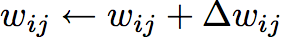
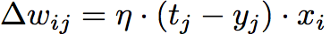
Perceptron Learning = Updating the Weights
We want to change the values of the weights
Aim: minimize the error at the output
If E = t-y, want E to be 0
Use:
Sum of Squared Error (SSE)
Learning rate
Input
Error

Slide 8
𝛈: the learning rate
The cost of having a small learning rate is that the weights need to see the inputs more often before they change significantly, so that the network takes longer to learn. However, it will be
more stable and resistant to noise (errors) and inaccuracies in the data. We therefore use
a moderate learning rate, typically 0.1 < < 0.4 , depending upon how much error we
expect in the inputs.

Slide 9
Example 1: The Logical OR
Initial values: w₀(0)=-0.05, w₁(0) =-0.02, w₂(0)=0.02, and η=0.25
Take first row of our training table: y₁= g(-0.05×-1 + -0.02×0 + 0.02×0 ) = 1
Take second row of our training table: y₁= g(0.2×-1 + -0.02×0 + 0.02×1 ) = 0
Until all recalls are correct.

Slide 10
Python implementation

Slide 11
Using NumPy

Slide 12
Decision boundary for OR perceptron

Slide 13
Perceptron Learning Applet
http://lcn.epfl.ch/tutorial/english/perceptron/html/index.html

Slide 14
Linear Separability

Slide 15
More than one neurons

Slide 16
The Perceptron Convergence Theorem ( Rosenblatt, 1962)
Given a linearly separable dataset, the Perceptron will converge to a solution that separates the classes, and that it will do it after a finite number of iterations.
The number of iterations is bounded by 1/d² , where d is the distance between the separating hyperplane and the closest data point to it.
Therefore, the Perceptron training algorithm runs in O(Tmn) time, with T iterations, m data points in n dimensions.

Slide 17
Adaptive Linear (Adaline) Neurons
Consider a linear activation function linear unit without threshold
𝛟(y)= w^{T}x= -w₀ + w₁ x₁ + … + w_{n} x_{n}
To minimize the Sum of Squared Error (SSE)
J[w] =(1/2)Σ_{d∈D} (t_{d}-y_{d})², where D is the set of training examples

Slide 18
Gradient Descent Learning Rule
Δw_{ij}= 𝜂x_{i}Σ_{d∈D} (t_{d}- 𝛟(y_{d}))
The weight update is calculated based on all samples in the training set (instead of updating the weights incrementally after each sample.
Also referred to as batch gradient descent.

Slide 19
The Exclusive Or (XOR) Function
The training algorithm does not converge, but keeps on cycling through two different wrong solutions.

Slide 20
In fact, it is always possible to separate out two classes with a linear function, provided that you project the data into the correct set of dimensions. There is a whole class of methods for doing this reasonably efficiently, called kernel classifiers, which are the basis of Support Vector Machines,

Slide 21
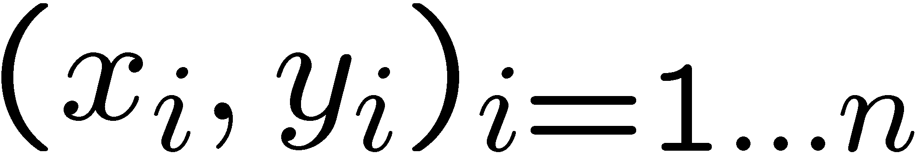
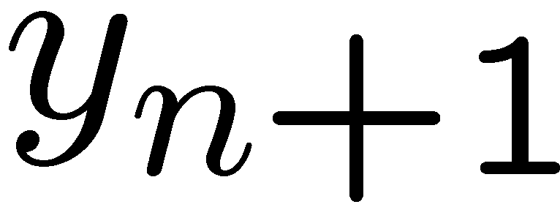
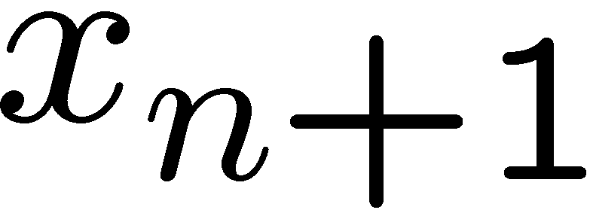
Linear Regression
40
26
24
Temperature
20
22
20
30
20
40
30
0
10
20
0
10
20
0
10
0
Given examples
Predict
given a new point
Notes:
Figure 1: scatter(1:20,10+(1:20)+2*randn(1,20),'k','filled'); a=axis; a(3)=0; axis(a);

Slide 22
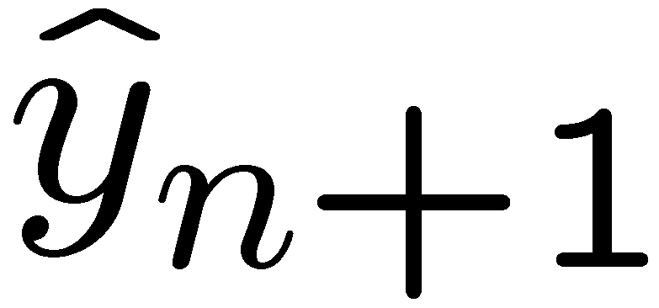
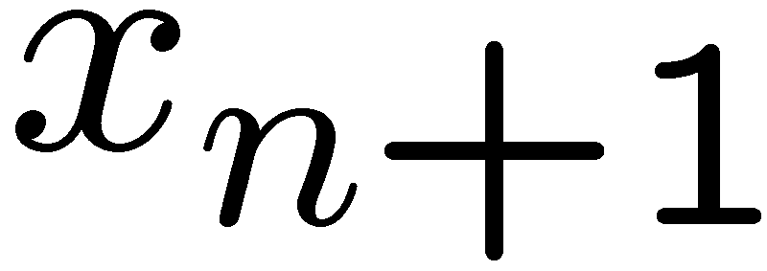
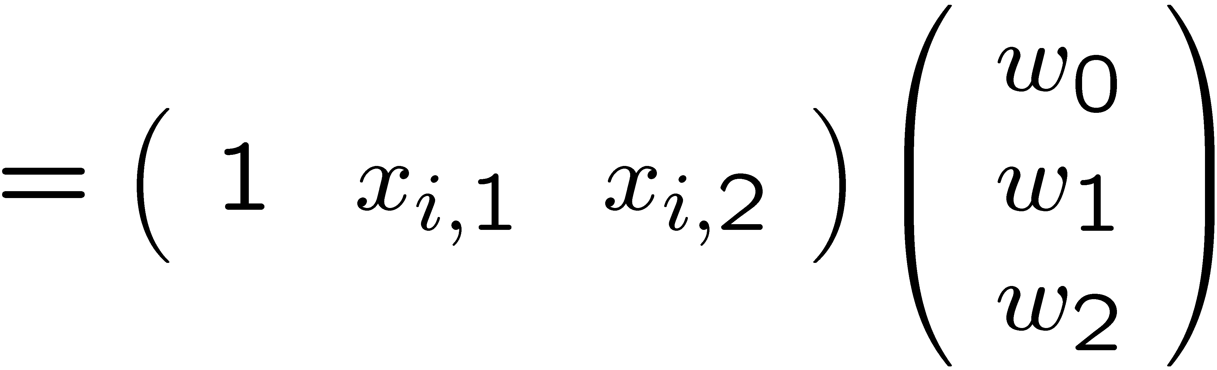
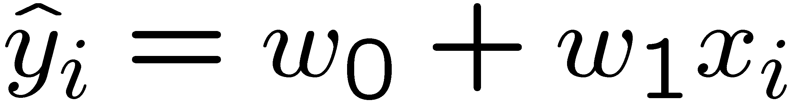
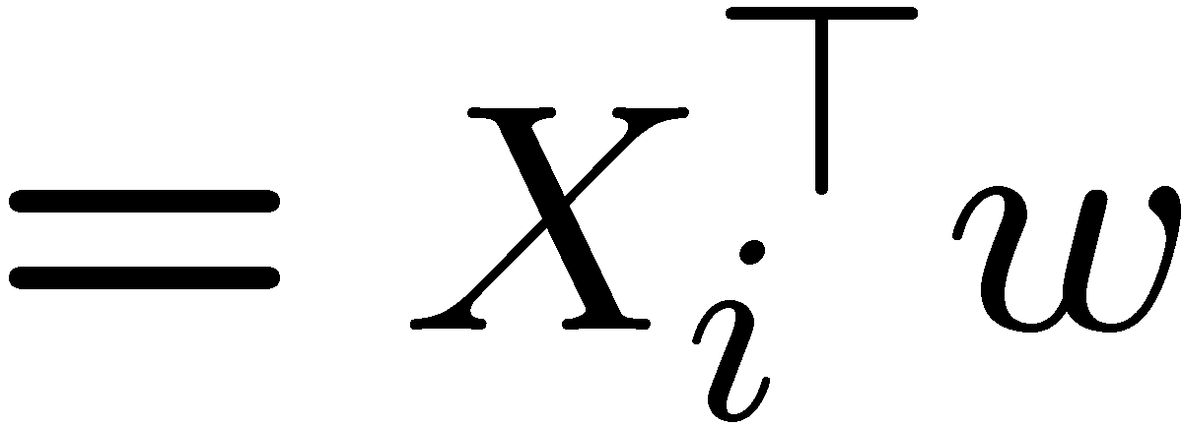
Linear regression
40
26
24
Temperature
20
22
20
30
20
40
30
0
Prediction
10
20
0
20
0
10
0
Prediction
Notes:
Figure 1: scatter(1:20,10+(1:20)+2*randn(1,20),'k','filled'); a=axis; a(3)=0; axis(a);

Slide 23


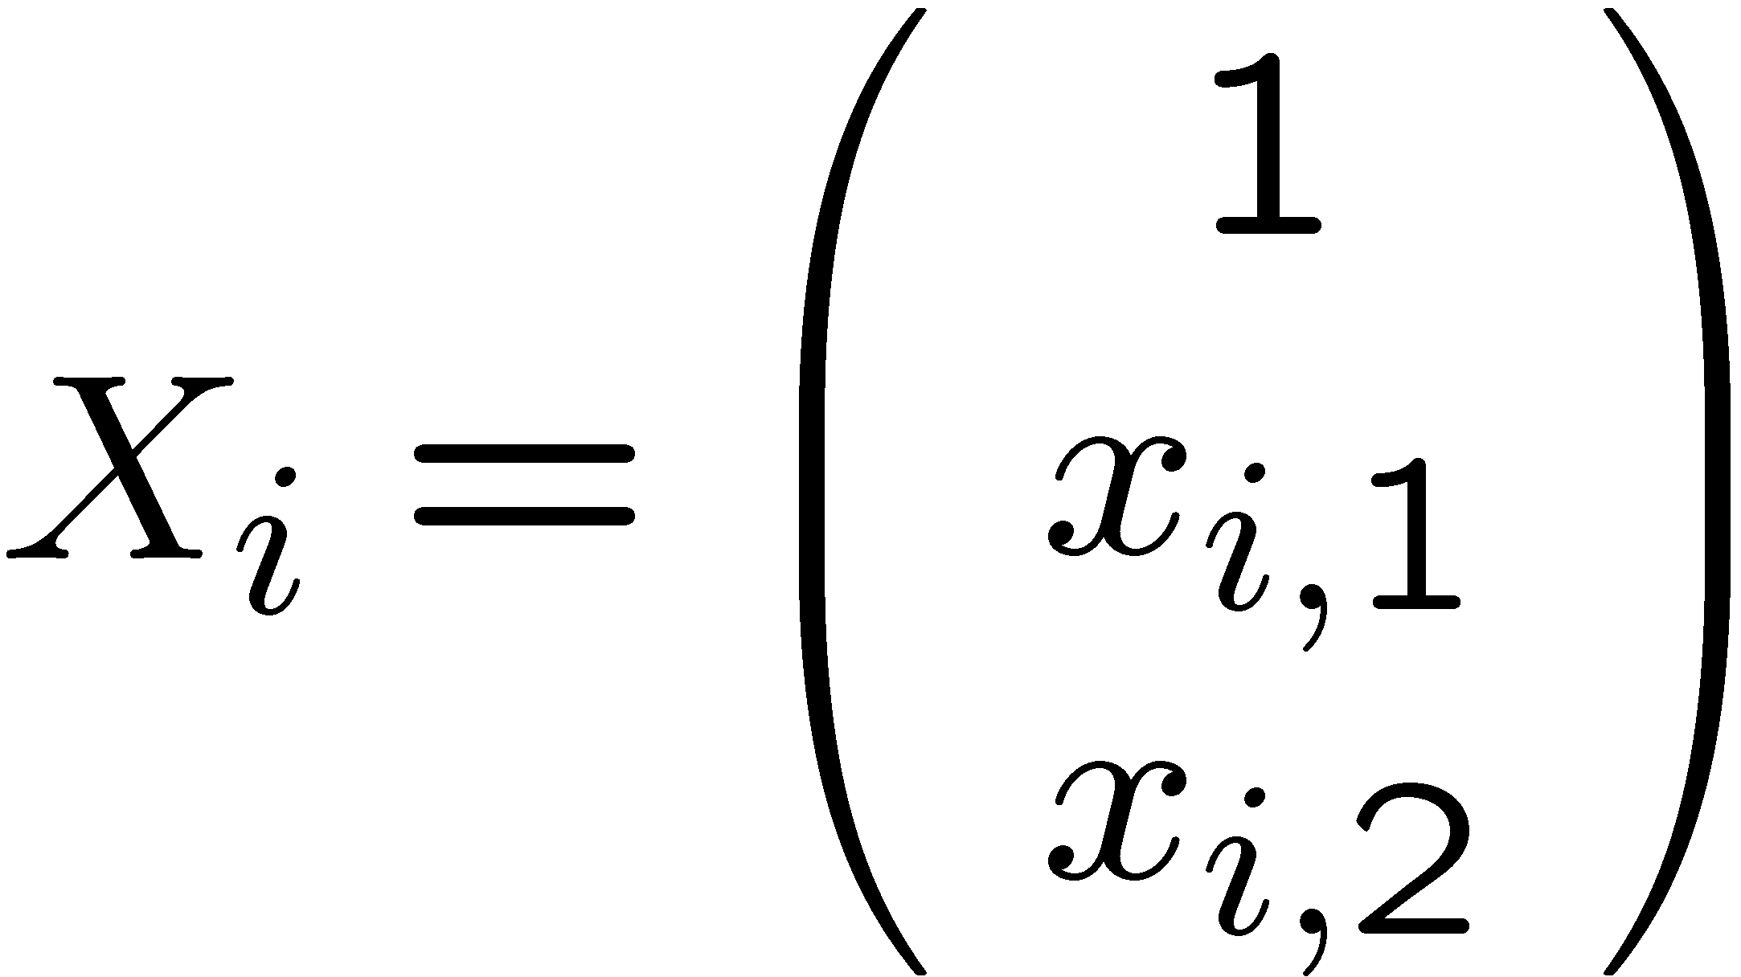

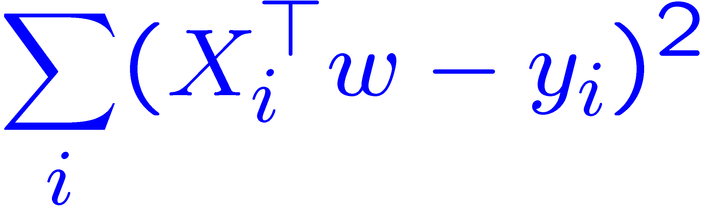
Ordinary Least Squares (OLS)
Error or “residual”
Observation
Prediction
0
0
20
Sum squared error
Notes:
Figure 1: scatter(1:20,10+(1:20)+2*randn(1,20),'k','filled'); a=axis; a(3)=0; axis(a);

Slide 24
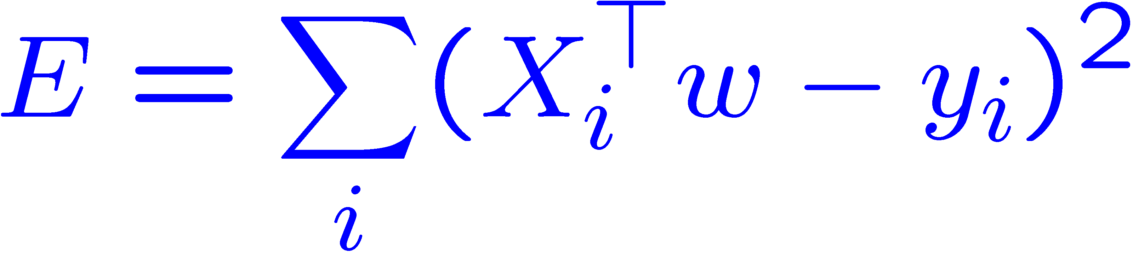
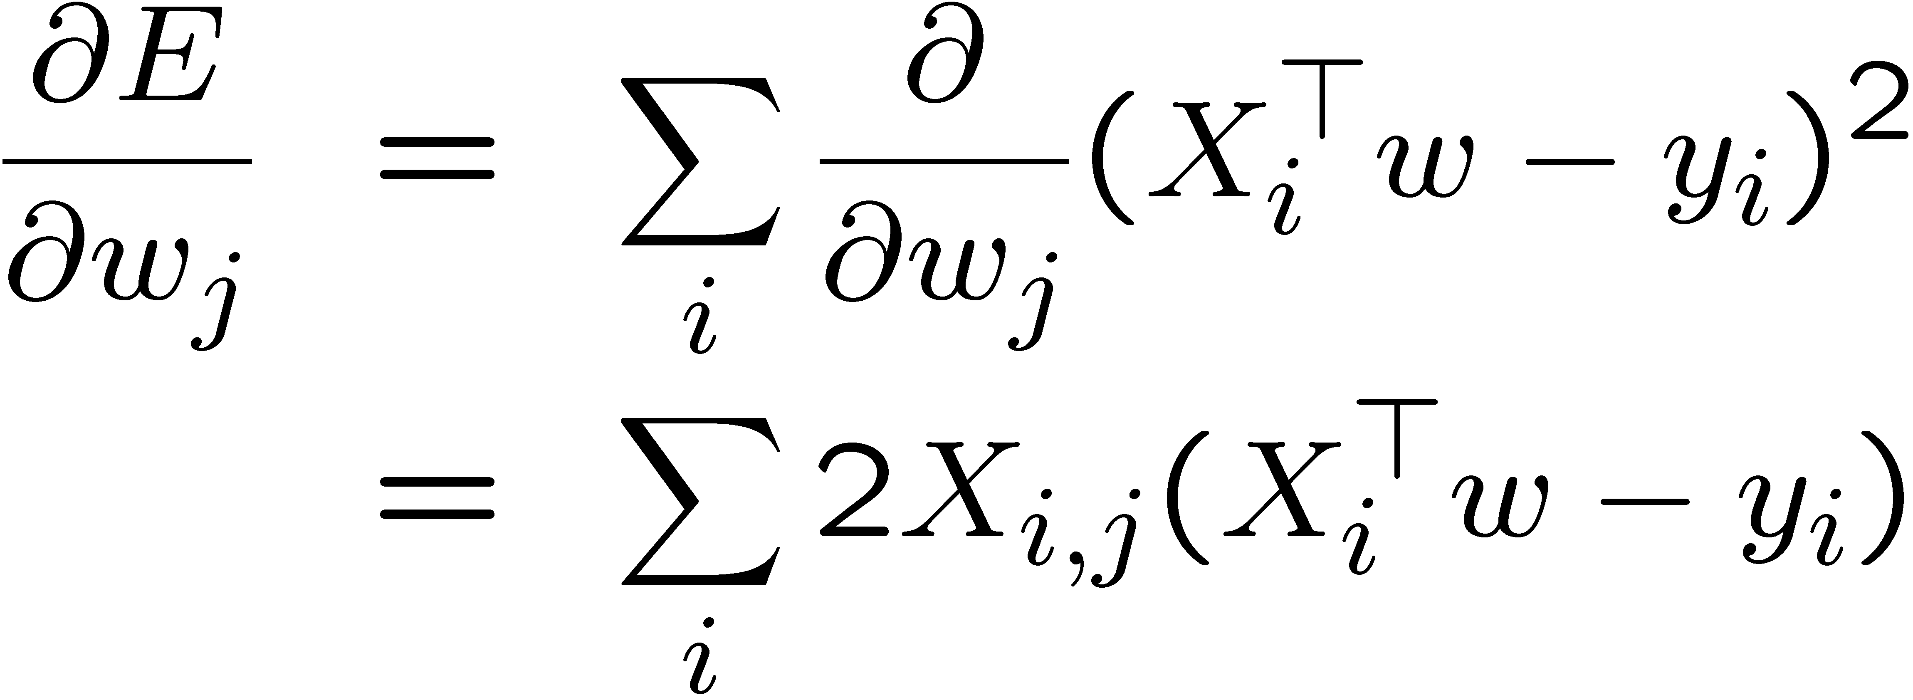
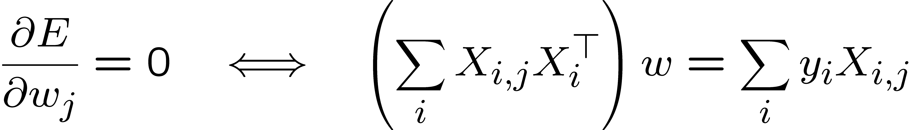
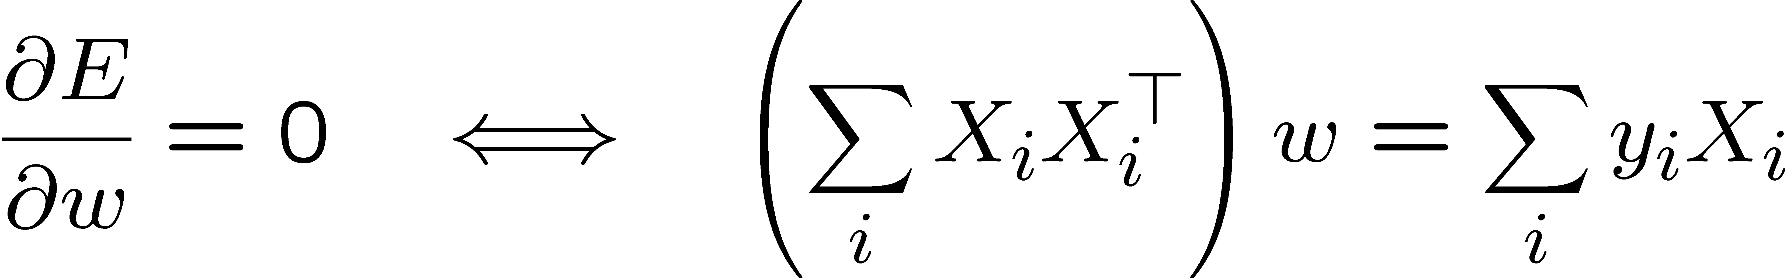



Minimize the Sum Squared Error (SSE)
Sum squared error
Linear equation
Linear system
1D case: y=ax+b
a = (nΣ(xy) - ΣxΣy) / (nΣx² - (Σx)²) b = (Σy – aΣx)/n

Slide 25
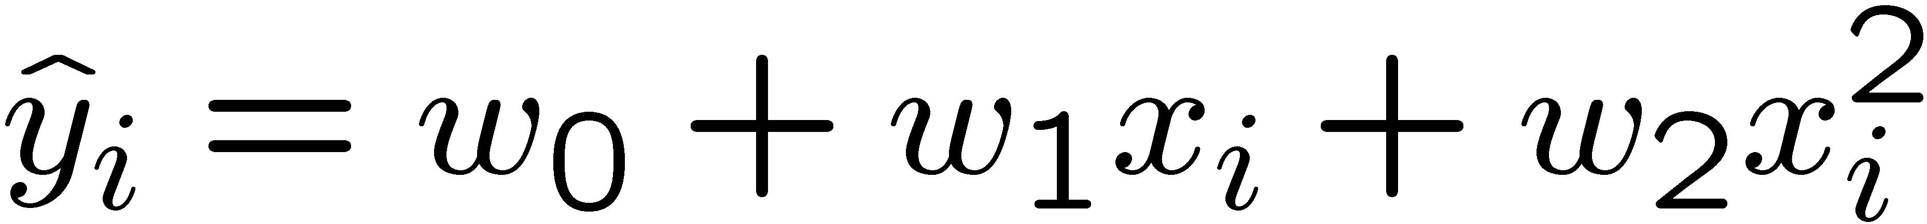

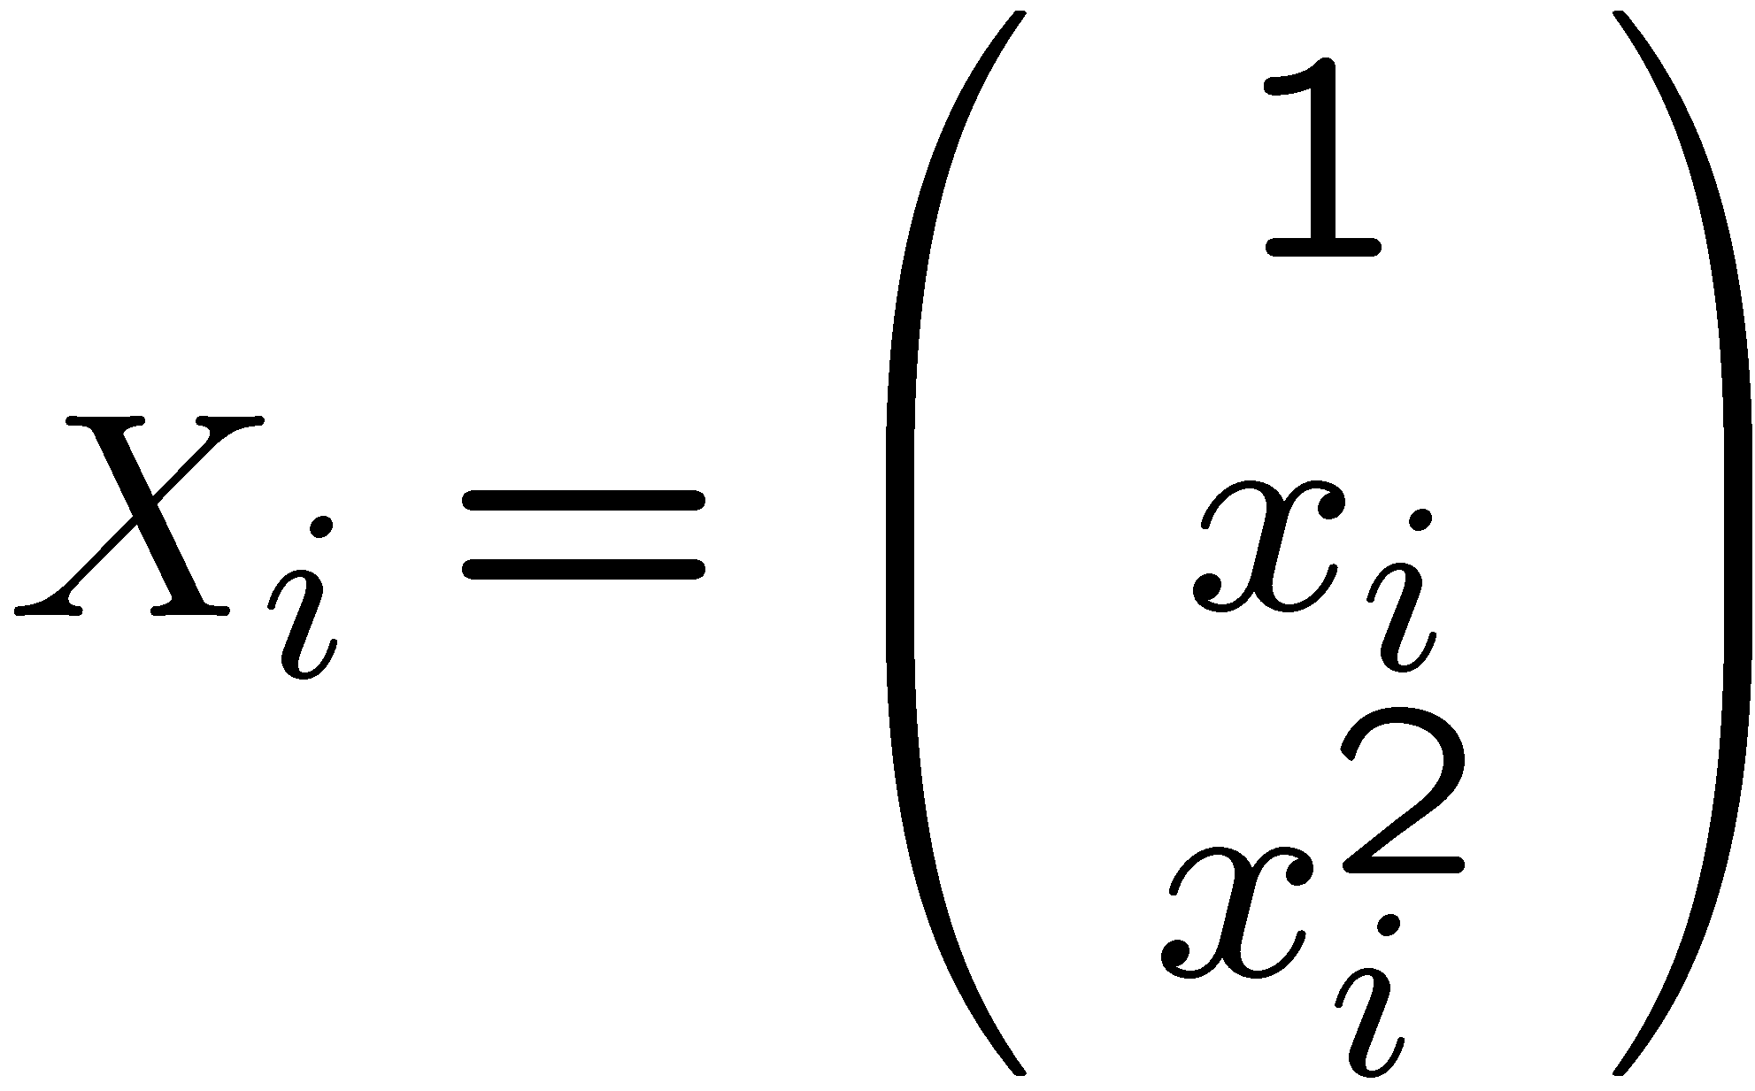
Beyond lines and planes
40
still linear in
20
0
0
10
20
everything is the same with

Slide 26
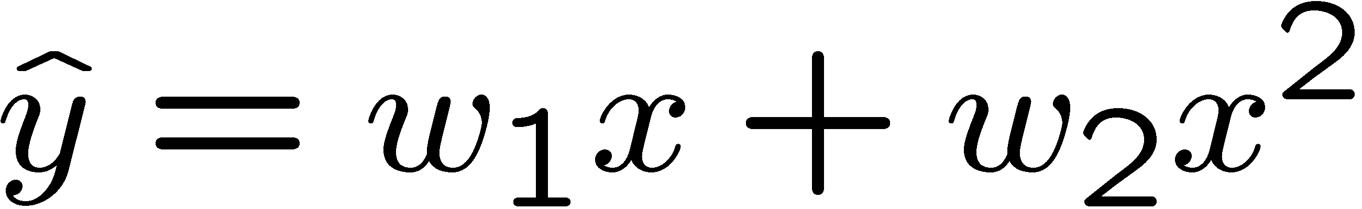
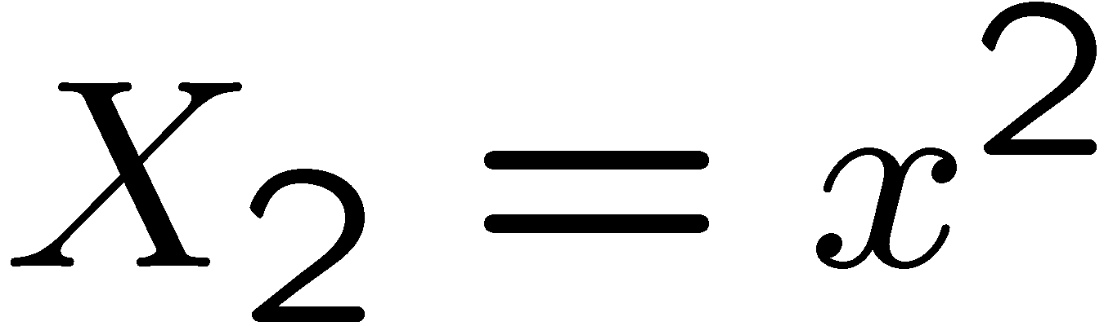
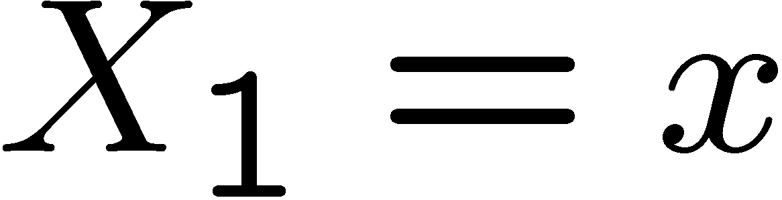
Geometric interpretation
20
10
400
0
300
-10
200
100
0
10
20
0

Slide 27

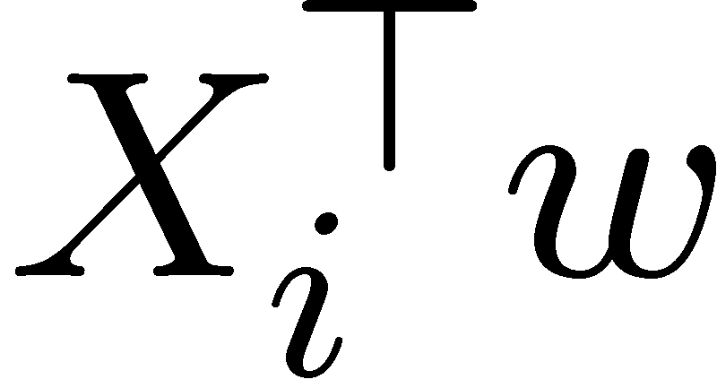
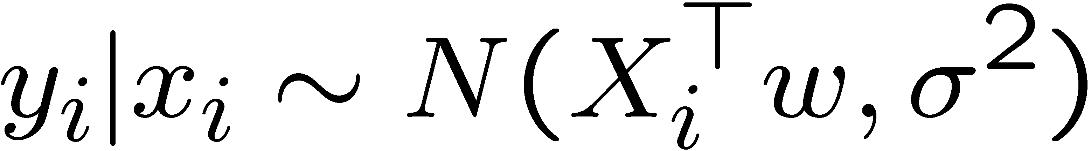
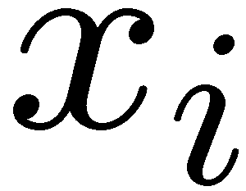

Probabilistic interpretation (Fisher, 1922)
0
0
20
Likelihood

Slide 28
Infer a probability by the predictor
Will someone have a heart attack over the next year?
Classification: Yes/No
The training data has binary output: did they have a heart attack or not?
We want to infer a probability from the data.

Slide 29
Logistic Regression (logit)
ln[p/(1-p)] = w^{T}x; or p =𝜃(x)=1/[1 + exp(-w^{T}x)]; 𝜃 – (logisitic) sigmoid function
p: the probability that an event y occurs, p(y=1)
p/(1-p): "odds ratio”; ln[p/(1-p)]: log odds ratio, or "logit”
The estimated probabilities between 0 and 1.
p=0.5 when w^{T}x =0
p→ 1 when w^{T}x gets really big,
p → 0 when w^{T}x gets really small

Slide 30
Comparing Linear and Logit Models
Y
Linear Model
1
Logit Model
0
X

Slide 31
Learning the coefficients: Gradient descent
Minimizing Error function:
Probabilistic interpretation: Maximum Likelihood Estimate (MLE)

Slide 32
Learning the coefficients: Gradient descent
The best (steepest) direction to move is the negative gradient:

